Slide 1

What’s New and Upcoming with Xamarin

Slide 2

Your Presenter, Shane Foley
Senior Consultant @ Neudesic
Current Technologies
Xamarin, .NET, Java
SQL, Couchbase, GraphQL, CosmosDB
SpecFlow
Angular 2+
Education
Bachelor of Computer Science @ ASU
Hobbies
Learning Tech, Riding Motorcycles, Working on Cars, Hiking, Traveling

Slide 3

Agenda
Shell Applications
What is it?
Setup
Using Shell (Demos)
When to use it
Hot Reloading
What is it?
Setup
Using Hot Reloading (Demo)
Comparing with other frameworks
CollectionViews
What is it?
How is it different than ListView
Setup
Examples

Slide 4
Shell Applications

Slide 5

What are Shell Applications?
URI based navigation experience
Does not have to follow navigation hierarchy
Basic pieces
Flyout
Tabs
Configurable properties
Page colors
Navigation bar
Tab bar
Etc.

Slide 6
Using the Shell
Steps to use the shell
Create a new Xamarin.Forms application
Add a XAML file to the shared code project
subclasses the Shell class
Set the MainPage property of the App class to the subclassed Shell object
Describe the visual hierarchy of the application in the subclassed Shell class

Slide 7
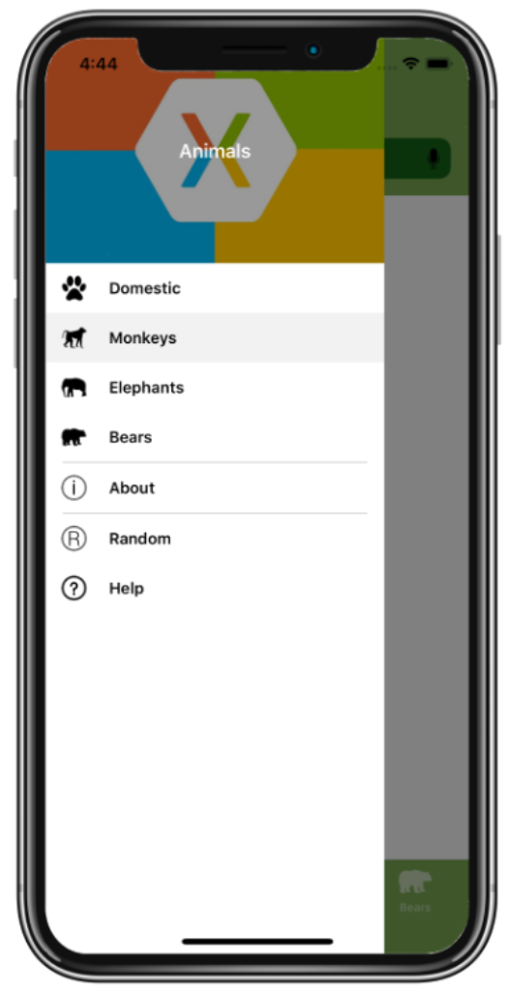
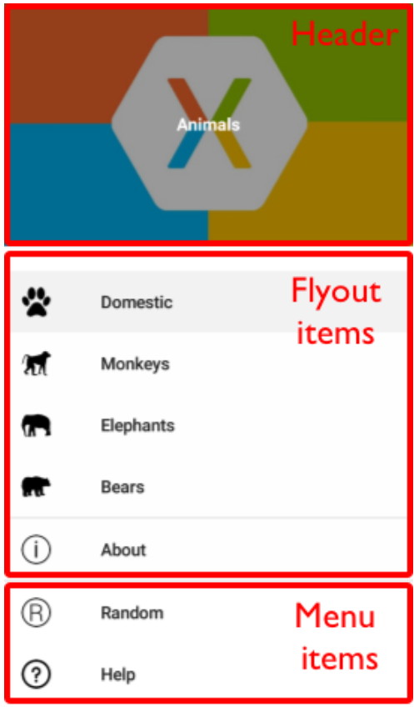
Shell: Flyouts
Root menu for a Shell application
Accessible through
Icon
Swipe
Three parts
Header
Flyout items
Basic navigation to other internal pages
Menu items
Clicked/Command handling
Enables external navigation
Documentation
https://docs.microsoft.com/en-us/xamarin/xamarin-forms/app-fundamentals/shell/flyout
Notes:
A flyout is the root menu for a Shell application. It is able to be accessed two ways: swipe, or icon. By default, the icon for a flyout is the hamburger icon to match industry standard, but this is able to be customized via property binding. There are three basic parts of a flyout: the header, flyout items, and menu items. The header allows you to set how the “header” top portion of a flyout. By default, this is a non-scrollable region of the flyout, but this is customizable. Flyout items are navigation related element that can take you to other internal views. These contain properties for titles and icons. The appearance of the flyout items is able to be customized using templates. Menu items are items at the bottom of the flyout. The menu items are distinct from flyout items because they expose clicked/command bindings that give the consumer more control of the behavior. For example, menu items can be used to open the browser to an external application.

Slide 8
Demo

Slide 9
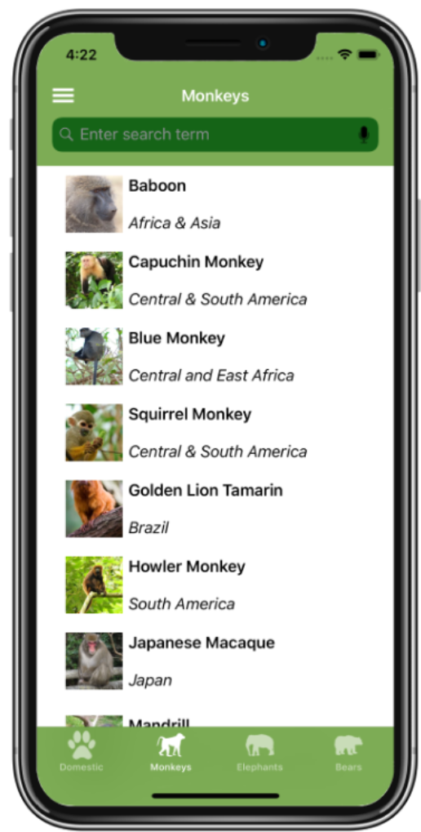
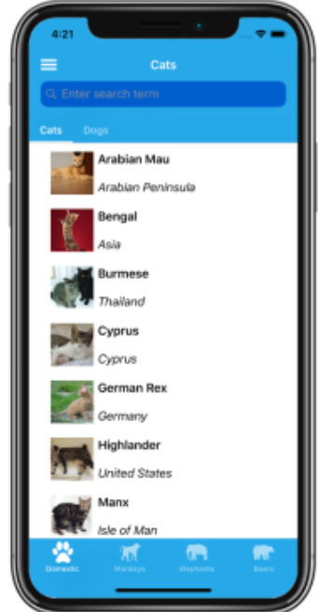
Shell: Tabs
Primary or secondary navigation for a Shell application
Single page application
Tab bar with single tab
Bottom tabs
Tab bar or flyout item with multiple tabs
Top tabs
More than one ShellContent object defined for a single tab
ContentPage title will be displayed
Documentation
https://docs.microsoft.com/en-us/xamarin/xamarin-forms/app-fundamentals/shell/tabs
Notes:
Tabs can either be a primary or secondary form of navigation for a Shell application. If the Shell contains a Flyout, then tabs are a secondary form of navigation. If the Shell contains a TabBar, then tabs are the primary form of navigation in the application. For a single page application, the Shell would contain a TabBar with a single tab. For a single page application, the TabBar will be hidden by default. A TabBar will be displayed by default if it includes multiple Tab objects. For each Tab, you can define a title and an icon. Each tab will include one or more ShellContent object, with the Content property set to a ContentPage. If more than one ShellContent objects are defined for a single Tab object, then a top tab bar will be displayed. The text in the top tab bar will include the title of the ContentPage.

Slide 10
Demo

Slide 11

Shell: Page Configuration
Shell applications allow you to configure your color scheme
Background color
Disabled color
Foreground color
Title color
Unselected color
You may also customize a TitleView
Documentation
https://docs.microsoft.com/en-us/xamarin/xamarin-forms/app-fundamentals/shell/configuration
Notes:
With Shell Applications, you may also easily customize the appearance of your application. This includes appearance of background, disabled/forground/unselected title and icons, and title color. Additionally, we can customize a TitleView to be displayed if we do not want to simply display the ContentPage title. Note, a TitleView is size restricted, so you will likely need to make use of width and height requests.

Slide 12
Shell: Navigation
URI based navigation
Do not need hierarchy
GoToAsync()
Routes
Components of a route
Route
Page
Query parameters
//{route}/page?queryParameters
Routes created by Shell, or manually defined
Notes:
Navigation within a Shell application it gives us the option of URI based navigation. This means that we do not need to build this entire hierarchy of pages that must exist in the backstack for our application to function. With shell navigation, we are provided with the GoToAsync function, which can be used to navigate from one route of your application, to another route. Routes are similar to what we would think of when navigating a website. The route relates the visual hierarchy built up in the shell. We end up defining routes on our flyout items, tabs, and shell content defined in the shell. Pages do not need to be part of the shell visual hierarchy, so any page can be pushed onto the stack. Query parameters give use the ability to pass parameters to our pages.

Slide 13
Demo

Slide 14

When to Use the Shell?
Proof of concepts
Production applications

Slide 15
Hot Reloading

Slide 16

Hot Reloading
What is it
Reflect XAML changes to a running application
Application state maintained
Benefits
Save time on builds for most UI updates
Able to handle rude edits
Current limitations
NuGet updates
Shell structure updates
Linking limitations
Special setup for physical iPhones
No C# updates
Notes:
Hot Reloading in Xamarin Forms allows us to reflect XAML changes in a running application. When this happens, the application state that was developed while running the application is maintained. The benefit of this is that most UI updates are able to be reflected in a running application. This is with the exception of namespace aliasing and other major structural changes. Additionally, rude edits are reflected with intellisense, and does not crash the running application. Instead, once the rude edits are resolved, then the XAML updates will continue to be reflected. Hot reloading does come with a number of limitations with Xamarin, such as the following: NuGet cannot be updated while application is running, shell structure updates can cause crashes, linking is limited to “none” option, special setup is required for physical iPhones, and C# code cannot be updated.

Slide 17
Getting Started
Install the following
Visual Studio 2019 16.3+
Xamarin.Forms 4.1+
Windows
Tools → Options → Xamarin → Hot Reload
Mac
Visual Studio → Preferences → Projects → Xamarin Hot Reload
Notes:
To use hot reloading, you will need to have the following installed: Visual Studio 2019 16.3+, and Xamarin.Forms 4.1+. The setup can be done within Xamarin configuration. It is just a checkbox option, but it is turned off by default since the feature is still in preview.

Slide 18
Demo

Slide 19
Comparison
Xamarin | Flutter
XAML Only | Most code changes supported. Exceptions: enum changes generic type declarations modified
Notes:
How does Xamarin’s version of hot reloading compare with the competition? For this I will be comparing with Flutter since that is within my domain of experience. As mentioned before, Xamarin hot reloading is reserved for XAML changes. There is no ability for us to make C# code changes and have it reflected in the running application. As for Fluttter, most code changes are supported, whether it is UI or logical changes. With Flutter, there are a few exceptions to what code changes can be made, but they are less restrictive than Xamarin.

Slide 20
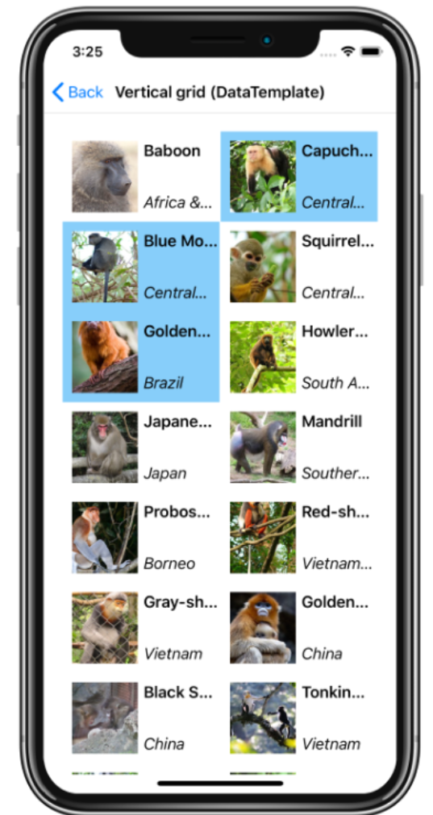
CollectionView

Slide 21
What is the CollectionView?
Flexible way to present data
Data
Populated via ItemsSource property with IEnumerable
We customize UI by defining an ItemTemplate
Selection
Single or multiple
Presentation
Vertical or horizontal
Empty list UI easily controlled
Scrolling
Controlled by user or programmatic (ScrollTo)
Allows grouping
Notes:
The CollectionView is a new flexible way to present IEnumerable data to the user. The data is populated using the ItemsSource

Slide 22
Differences from List View
Vertical or horizontal
Single or multiple selection
GridItemsLayout
Automatically utilizes virtualization provided by native

Slide 23
Getting Started
Requirements
Xamarin.Forms 4.0+
iOS
Add the following to your AppDelegate
Forms.SetFlags("CollectionView_Experimental");
Android
Add the following to your MainActivity
Forms.SetFlags("CollectionView_Experimental");

Slide 24
Demo

Slide 25

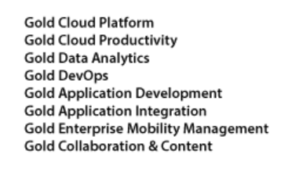


Why Work at Neudesic?
Neudesic is home to smart, talented and motivated people. People who want to work for an innovative company that values their skills and keeps their passions alive with new challenges and opportunities.
Passion: Neudesic is a technology-oriented company and a common thread you will find throughout the organization is a passion by its employees for technology, to stay on the bleeding-edge, and the desire to work on highly interesting, complex solutions.
Innovation: Passion for technology drives us. But it’s innovation that defines us. We approach challenges from a unique perspective which allows us to create ideas, products and solutions that change the game.

Slide 26
Careers at Neudesic
Custom Application Development
Predictive Enterprise (Data Analytics & Engineering)
Cloud Infrastructure Services
Project Management & Delivery
IDX (User Experience)
Ask me about openings or contact
our local recruiter: Tony Brownell (Tony.Brownell@neudesic.com)

Slide 27

Questions

